Slide 1
CS 179: Lecture 12 Recitation
cuBLAS, cuSolver, and Point Alignment

Slide 2
Homework 4 Released Tonight
-Will be most likely due Friday
-Due date will overlap with set 5, which will be released Wednesday as usual.
- Recommend to turn in Homework 4 by next wednesday
- Set 4 is intentionally easy (hopefully), should give you time to prepare for midterms in other classes.

Slide 3
Recap
cuBLAS is CUDA’s linear algebra library!
Good for operations between vectors, matrices, etc.
Feels like Matlab, Numpy, etc. E Z
Heavily optimized
Very general, can use in many applications. For example, many cublas functions subsume some of the reductions that we have been writing by hand so far such as parallelized max or parallelized sum.
Why ever write your own kernels?
More control, sometimes allows for less data i/o
Many calls can increase overhead
Bad support / growing environment

Slide 4
Today
Finish covering cuBlas via example
What is cuSolver?
Matrix factorization
Parallel LU solve
Point alignment
Like least squares
Will solve for a linear transformation that matches one set of points to another

Slide 5
Cublas Example

Slide 6
What is cuSolver
There are primitive linear solver capabilities within cuBLAS
Under BLAS-like extensions
Mostly very primitive, not very well supported.
cuSOLVER is entirely designed for solving linear systems
Two big things:
Factorizations
Backsubstitution / solving factorized system
Great for dense linear systems

Slide 7
What is a linear system?
Want to solve this problem:
Ax = b
Know matrix A, know vector b, want to determine what vector x is.
Naive solution: Invert A if possible!
X = A⁻¹b
Worst solution! Bad numerical stability (same reason that 1/x generally unstable if x is small).

Slide 8
Naming Convention -- Like cuBLAS
cusolverDn<t><operation>

Slide 9
Also Has handle
cusolverStatus_t
cusolverDnCreate(cusolverDnHandle_t *handle);

Slide 10
Factorizations?
Fact:
Can factorize any matrix A into the following form:
P A = L U
L = Lower Triangular (1’s on diagonal)
U = Upper triangular
P = Permutation matrix (for numerical stability)

Slide 11
Why useful?
Want to solve
Ax = b
LU x = P b
=> Solve
L y = Pb
U x = y

Slide 12
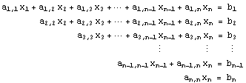
Solving triangular matrices is easy!
Backsubstitution.
Can solve multiple RHS simultaneously!

Slide 13
Multiple RHS
Furthermore, multiple RHS increases the parallelism of the application.
Can improve performance, even over fast and optimized CPU code!
http://citeseerx.ist.psu.edu/viewdoc/summary?doi=10.1.1.2.9349

Slide 14
How to solve on the hw?
cusolverDn<t>getrf()
cusolverDn<t>getrs()
Will do some of the solves simultaneously.

Slide 15
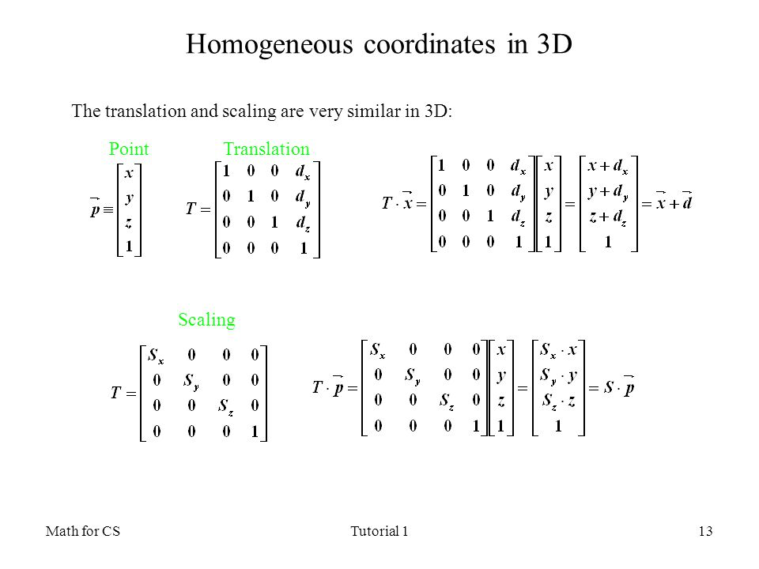
Point Alignment
Everything in homogeneous coordinates (bias term in ML-lingo)
Want to find matrix M of size 4 x 4
Points X1, N x 4 match to X2, N x 4
Looks like least squares, we will solve:
X1^{T}X1 . M^{T} = X1^{T}X2
Linear system!

Slide 16
Multiple RHS!
X1^{T}X1 . M^{T} = X1^{T}X2
Minimizes distance from X1 points transformed by M to points X2.
Set bottom row of M to zero with a 1 at the end.

Slide 17
Questions?

